Slide 1
The new
Director Certification Program (DCP) on the
Learning Management System (LMS)
Director Education for Everyone

Slide 2
What is the DCP (Director Certification Program)?
An educational, self-paced program, now ONLINE in a Learning Management System.
An opportunity to validate the skills and knowledge required to direct a Sweet Adelines chorus, and earn advanced directing credentials.
A set of materials available to all members to increase their understanding of barbershop singing and of what it takes to direct a barbershop chorus.

Slide 3
What is the LMS (Learning Management System)?
An online, easy, self-paced way to study. Start and stop at YOUR convenience. Eliminates time zone issues!
No bulky manuals! Everything is accessed on-line.
A graphical user interface with different ways of presenting information (flash cards, embedded videos, photos from quartet and chorus contests, and graphics from both online and textbook resources).
Includes short self-tests at the end of every topic to help cement your learning.

Slide 4
What’s in it for Front-Line Directors?
Tests assessing competency in any of the module areas can be taken at any time. The LMS eliminates time zone issues and makes proctoring easy over Zoom.
Successful completion of the module tests earns the participant a certification, if they are a front-line director.
With a certificate and at least one year of front-line directing experience, a director is eligible to earn greater recognition based on chorus achievement at competition.
  Harmony 500 Director
  Master Director
  Master 700 Director

Slide 5
What’s in it for Musical Leaders?
Assistant Directors
Improve conducting skills
Improve teaching and coaching skills
Learn more about doing PVIs
Improve communication
Improve analytical listening skills
Learn to read music better
Learn how to make rehearsals and performances more productive and enjoyable
Section Leaders
Get better at starting and stopping your section
Learn more about doing PVIs
Improve communication
Improve analytical listening skills
Learn to read music better

Slide 6
What’s in it for “Regular Chorus Members”?
Review any of the modules, in any order you choose, at any time, for a low per-module price
No requirement to be enrolled in the DCP for certification
No testing required, just read and learn
Appreciate what your director knows and does
Find new ways to support and assist your director, assistant director, or section leader

Slide 7
What are the Modules?
1: Conducting Skills
2: Analytical Listening
3: Organizational Knowledge and Director Resources
4: Teaching and Coaching Skills
5: Management Skills
6: Judging Categories and Competition
7: Vocal Production
8: Communication Skills
9: Music Theory
10: Rehearsal Planning
11: Performance
Introduction to the DCP (free for everyone)
DCP Admin Guide (for Regional DCP Coordinators)

Slide 8
Introduction to the DCP
Introduction is “Module Zero” to make sure everyone understands the basics and the latest changes. It’s free on the International website!
Elements of the DCP
How to enroll
Steps for advancement
Navigating the DCP
Taking tests
Certifications and awards
Inform and inspire others to join the DCP!

Slide 9
Module 1 – Conducting Skills
Considerations for beginning directors
Basic elements of conducting, including hand posture, basic beat patterns, preparatory (breath) beat, and the ictus
Uptune vs. ballad conducting skills
Rehearsal vs. performance conducting skills
Dealing with common issues encountered
in rehearsal
Many examples of directors using
different conducting styles
“Arm-waving”
for everyone

Slide 10
Module 2 – Analytical Listening
Trains the “ears in front” to hear and identify issues, and develop a plan to fix them.
Examples of musical problems often heard in vocal groups, and ways to deal with them.
Focuses on what the director hears, even
though issues may have to do with
physical/visible behavior
Train your ears

Slide 11
Module 3 – Organizational Knowledge and Director Resources
Chapter / regional / international organization
International Board of Directors (IBOD) and HQ Staff
International Committees and Task Forces
Chorus Management Team and Board options
Ways to get more involved in Sweet Adelines
Additional resources for directors
Copyright information for directors
Brief history of barbershop
Do you know how we work?

Slide 12
Module 4 – Teaching and Coaching Skills
Teaching adult learners
Methods for teaching a new song and basic skills
Ways to develop musicianship as a song advances
Rehearsal tools to add variety
Introducing a visual plan
The director as chorus coach
Considerations when hiring an
outside coach
How to reach ‘em and teach ‘em

Slide 13
Module 5 – Management Skills
Leading vs. managing a chorus
The Director’s role in chorus management
Developing a music staff
Developing a Quality Assurance Program
Importance of the Director with guests
and new members
The cycle of directing
Directors play a big role in successful chorus operations

Slide 14
Module 6 – Judging Categories and Competition
Benefits of competition
Description of all types of competitions: Regional, International, Open Division, Harmony Classic
Brief description of what judges are looking for in each category (Sound, Music, Expression,
Visual Communication)
Selecting and analyzing music
Preparing for competition
Dealing with competition results
How to handle the entire competition experience

Slide 15
Module 7 – Vocal Production
Article Topic | Primary Author
Anatomy and Physiology | Caitlin Castelino
Alignment | Mary Rhea
Breathing for Singing | Lori Lyford
Phonation | Sandy Marron
Resonation | Dale Syverson
Vowels and Diphthongs | Betty Clipman
Consonants | Ryan Heller
Vocal Registers | Kim Vaughn
Dynamic Flexibility | Anne Downton
Vocal Exercises | Peggy Gram
Vocal Health | Britt-Helene Bonnedahl & Vickie Maybury
All members will benefit from reviewing this material!

Slide 16
Module 8 – Communication Skills
Verbal and non-verbal communication
The cycle of communication
Best practices for all types of communication
Your style of communicating
Listening skills
Giving and receiving feedback
Communication and technology
Communicating is the most important part of the Director’s job

Slide 17
Module 9 – Music Theory
Identifying notes
Note and rest time values
The staff and scales
Key signatures
Time signatures
Intervals
Rhythms
Chords
Get more comfortable with those dots on the page

Slide 18
Module 10 – Rehearsal Planning
How to bring singers the best night of the week, every week
Long-range goal-setting to week-to-week planning
The importance of good warmups
Several options for riser placement
The power of section rehearsals
Rehearsing online
What makes a rehearsal great?
The rehearsal is where it all starts…

Slide 19
Module 11 – Performance
Presenting a successful performance
Foundations of performance skills
Planning performances
On performance day
Managing stage fright
Mental preparation
Using sound equipment
Prepare and plan for maximum impact in performance

Slide 20
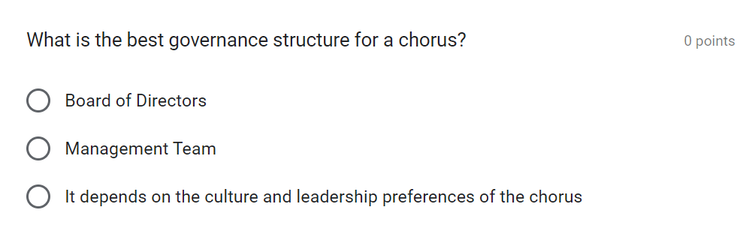
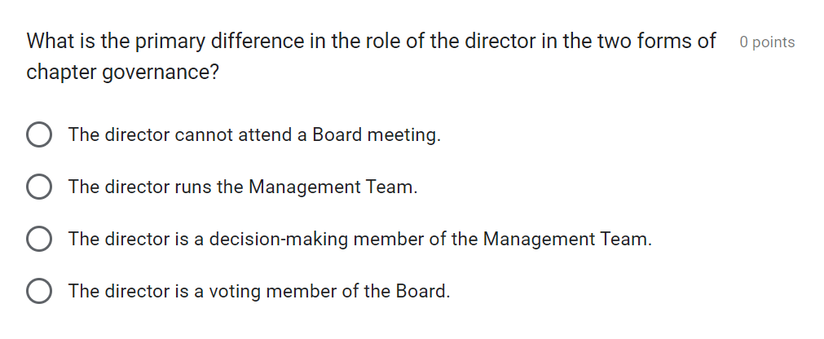
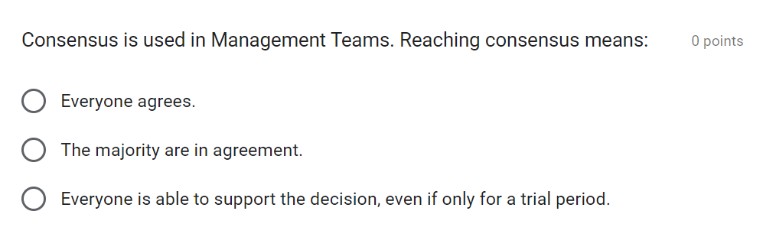
Self-Test Quizzes
Three questions at the end of each article check your understanding of what you just read
No grading; self-assessment only
Immediate responses that either congratulate you on your understanding or send you back to a specific section for more review

Slide 21
Scoring and Testing is More Consistent
(for those taking DCP tests)
All modules have a written evaluation, which everyone enrolled in the DCP can take. Passing written evaluations with a minimum score of 60% on each module earns Approved Director status.
Five modules ALSO have a practical assessment, which only front-line/co-directors, assistant or associate directors may take. Passing written evaluations AND practical assessments with a minimum score of 60% on each module earns Certified Director status.

Slide 22
Suggestions
Even if you’ve completed the DCP, consider investing in updated modules to stay current.
If you’re a Director, encourage your music team to review updated modules. Study them for training and development.
Encourage anyone to enroll who is curious about any aspect of what a director does. It’s great education!

Slide 23
Spread the Word!
The EDC knows the value of educating directors and musical leaders, and has invested in:
A standing committee to keep the DCP current
An online Learning Management System to make the learning easier, more accessible, and more fun
Share the exciting news!

